Slide 1
Quick Sort (11.2)
CSE 2011
Winter 2011

Slide 2
Quick Sort
Fastest known sorting algorithm in practice
Average case: O(N log N)
Worst case: O(N²)
  But the worst case can be made exponentially unlikely.
Another divide-and-conquer recursive algorithm, like merge sort.

Slide 3
Quick Sort: Main Idea
If the number of elements in S is 0 or 1, then return (base case).
Pick any element v in S (called the pivot).
Partition the elements in S except v into two disjoint groups:
  S₁ = {x ∈ S – {v} | x ≤ v}
  S₂ = {x ∈ S – {v} | x ≥ v}
Return {QuickSort(S₁) + v + QuickSort(S₂)}

Slide 4
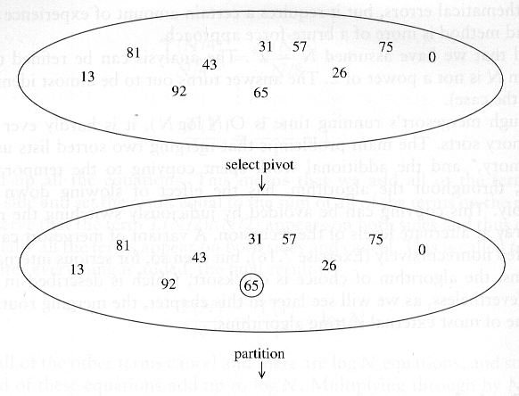
Quick Sort: Example

Slide 5
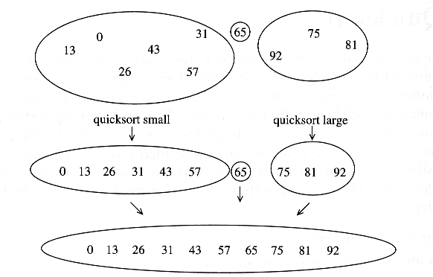
Example of Quick Sort...

Slide 6
Issues To Consider
How to pick the pivot?
  Many methods (discussed later)
How to partition?
  Several methods exist.
  The one we consider is known to give good results and to be easy and efficient.
  We discuss the partition strategy first.

Slide 7
Partitioning Strategy
For now, assume that pivot = A[(left+right)/2].
We want to partition array A[left .. right].
First, get the pivot element out of the way by swapping it with the last element (swap pivot and A[right]).
Let i start at the first element and j start at the next-to-last element (i = left, j = right – 1)
swap
5
7
4
6
3
12
19
5
7
4
19
3
12
6
pivot
i
j

Slide 8
Partitioning Strategy
Want to have
  A[k] ≤ pivot, for k < i
  A[k] ≥ pivot, for k > j
When i < j
  Move i right, skipping over elements smaller than the pivot
  Move j left, skipping over elements greater than the pivot
  When both i and j have stopped
    A[i] ≥ pivot
    A[j] ≤ pivot ⇒ A[i] and A[j] should now be swapped
≤ pivot
≥ pivot
i
j
5
7
4
19
3
12
6
5
7
4
19
3
12
6
i
j
i
j

Slide 9
Partitioning Strategy (2)
When i and j have stopped and i is to the left of j (thus legal)
  Swap A[i] and A[j]
    The large element is pushed to the right and the small element is pushed to the left
  After swapping
    A[i] ≤ pivot
    A[j] ≥ pivot
  Repeat the process until i and j cross
swap
5
7
4
19
3
12
6
5
3
4
19
7
12
6
i
j
i
j

Slide 10
Partitioning Strategy (3)
5
3
4
19
7
12
6
When i and j have crossed
  swap A[i] and pivot
Result:
  A[k] ≤ pivot, for k < i
  A[k] ≥ pivot, for k > i
i
j
5
3
4
19
7
12
6
j
i
swap A[i] and pivot
5
3
4
6
7
12
19
Break!
j
i

Slide 11
Picking the Pivot
There are several ways to pick a pivot.
Objective: Choose a pivot so that we will get 2 partitions of (almost) equal size.

Slide 12
Picking the Pivot (2)
Use the first element as pivot
  if the input is random, ok.
  if the input is presorted (or in reverse order)
    all the elements go into S₂ (or S₁).
    this happens consistently throughout the recursive calls.
    results in O(N²) behavior (we analyze this case later).
Choose the pivot randomly
  generally safe,
  but random number generation can be expensive and does not reduce the running time of the algorithm.

Slide 13
Picking the Pivot (3)
Use the median of the array (ideal pivot)
  The ⎡N/2⎤ th largest element
  Partitioning always cuts the array into roughly half
  An optimal quick sort (O(N log N))
  However, hard to find the exact median
Median-of-three partitioning
  eliminates the bad case for sorted input.
  reduces the number of comparisons by 14%.

Slide 14
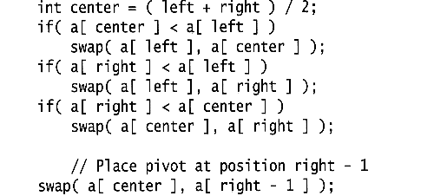
Median of Three Method
Compare just three elements: the leftmost, rightmost and center
  Swap these elements if necessary so that
    A[left] = Smallest
    A[right] = Largest
    A[center] = Median of three
  Pick A[center] as the pivot.
  Swap A[center] and A[right – 1] so that the pivot is at the second last position (why?)

Slide 15
Median of Three: Example
2
5
6
4
13
3
12
19
6
A[left] = 2, A[center] = 13, A[right] = 6
2
5
6
4
6
3
12
19
13
Swap A[center] and A[right]
2
5
6
4
6
3
12
19
13
Choose A[center] as pivot
pivot
2
5
6
4
19
3
12
6
13
Swap pivot and A[right – 1]
pivot
We only need to partition A[ left + 1, …, right – 2 ]. Why?

Slide 16
Quick Sort Summary
Recursive case: QuickSort( a, left, right )
  pivot = median3( a, left, right );
  Partition a[left … right] into a[left … i-1], i, a[i+1 … right];
  QuickSort( a, left, i-1 );
  QuickSort( a, i+1, right );
Base case: when do we stop the recursion?
  In theory, when left >= right.
  In practice, …

Slide 17
Small Arrays
For very small arrays, quick sort does not perform as well as insertion sort
Do not use quick sort recursively for small arrays
  Use a sorting algorithm that is efficient for small arrays, such as insertion sort.
When using quick sort recursively, switch to insertion sort when the sub-arrays have between 5 to 20 elements (10 is usually good).
  saves about 15% in the running time.
  avoids taking the median of three when the sub-array has only 1 or 2 elements.

Slide 18
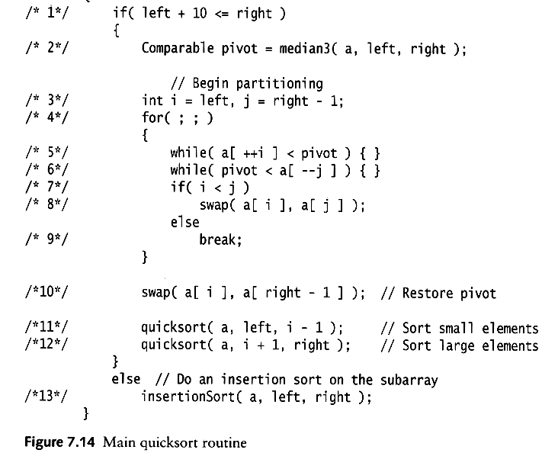
Quick Sort: Pseudo-code
Choose pivot
Partitioning
Recursion
For small arrays

Slide 19
Partitioning Part
The partitioning code we just saw works only if pivot is picked as median-of-three.
  A[left] ≤ pivot and A[right] ≥ pivot
  Need to partition only
  A[left + 1, …, right – 2]
j will not run past the beginning
  because A[left] ≤ pivot
i will not run past the end
  because A[right-1] = pivot

Slide 20
Homework
Assume the pivot is chosen as the middle element of an array: pivot = a[(left+right)/2].
Rewrite the partitioning code and the whole quick sort algorithm.

Slide 21
Quick Sort Faster Than Merge Sort
Both quick sort and merge sort take O(N log N) in the average case.
But quick sort is faster in the average case:
  The inner loop consists of an increment/decrement (by 1, which is fast), a test and a jump.
  There is no extra juggling as in merge sort.
inner loop

Slide 22
Analysis
Assumptions:
A random pivot (no median-of-three partitioning)
No cutoff for small arrays ( to make it simple)
If the number of elements in S is 0 or 1, then return (base case).
Pick an element v in S (called the pivot).
Partition the elements in S except v into two disjoint groups:
  S₁ = {x ∈ S – {v} | x ≤ v}
  S₂ = {x ∈ S – {v} | x ≥ v}
Return {QuickSort(S₁) + v + QuickSort(S₂)}

Slide 23
Analysis (2)
Running time
  pivot selection: constant time, i.e. O(1)
  partitioning: linear time, i.e. O(N)
  running time of the two recursive calls
T(N)= T(i) + T(N – i – 1) + cN
  i: number of elements in S1
  c is a constant

Slide 24
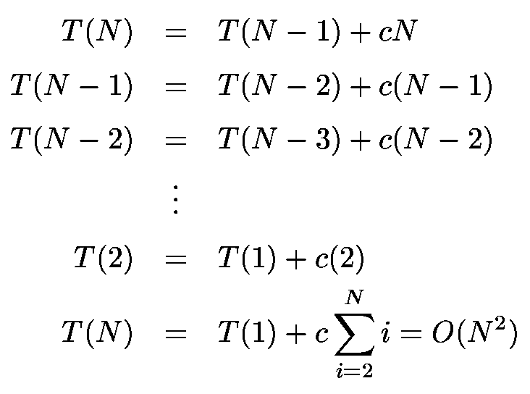
Worst-Case Scenario
What will be the worst case?
  The pivot is the smallest element, all the time
  Partition is always unbalanced

Slide 25
Best-Case Scenario
What will be the best case?
  Partition is perfectly balanced.
  Pivot is always in the middle (median of the array).
T(N) = T(N/2) + T(N/2) + cN = 2T(N/2) + cN
This recurrence is similar to the merge sort recurrence.
The result is O(NlogN).

Slide 26
Average-Case Analysis
Assume that each of the sizes for S₁ is equally likely ⇒ has probability 1/N.
This assumption is valid for the pivoting and partitioning strategy just discussed (but may not be for some others),
On average, the running time is O(N log N).
Proof: pp 272–273, Data Structures and Algorithm Analysis by M. A. Weiss, 2nd edition

Slide 27
Next time …
Arrays (review)
Linked Lists (3.2, 3.3)
Comparing sorting algorithms
Stacks, queues (Chapter 5)

